Slide 1

TRADE LIFE CYCLE MANAGEMENT SYSTEM
Amandeep Singh
001271649

Slide 2
ABSTRACT
This project is based on trade settled between various financial institutions in OTC market.
OTC is over the counter market where counterparties trade on the conditions that are decided by mutual understanding.
OTC market mainly deals in various products , but in this product we are only considering cash settlements.
Cash settlements in OTC market is also called as HEDGING of funds.
OTC trades includes various region and market products such as swaps , margins and broker fee.

Slide 3
PROBLEMS
Counterparties face difficulties in trade settlement due to specialist discrepancy.
Managing trade settlement in case of different regions or currency.
Effective management of defaulting counterparties and subsidiaries.
Performance management of specialist who is booking the trade and their respective teams.
Management of high value trades .
Management of trades settled in margins.
Revenue performance of financial institution.

Slide 4
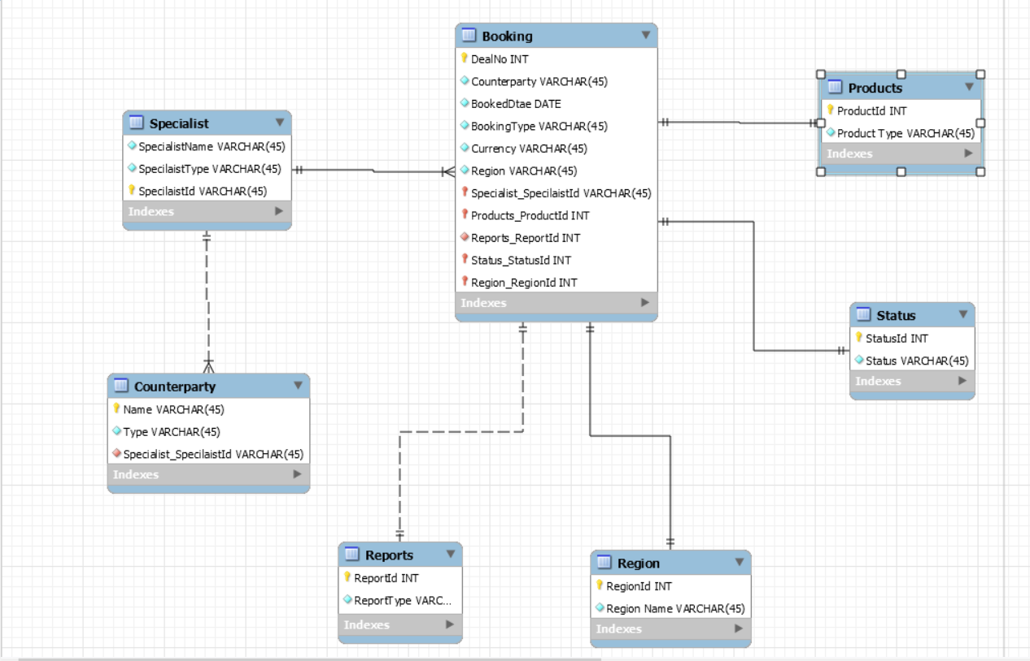
PREVIOUS ERD

Slide 5
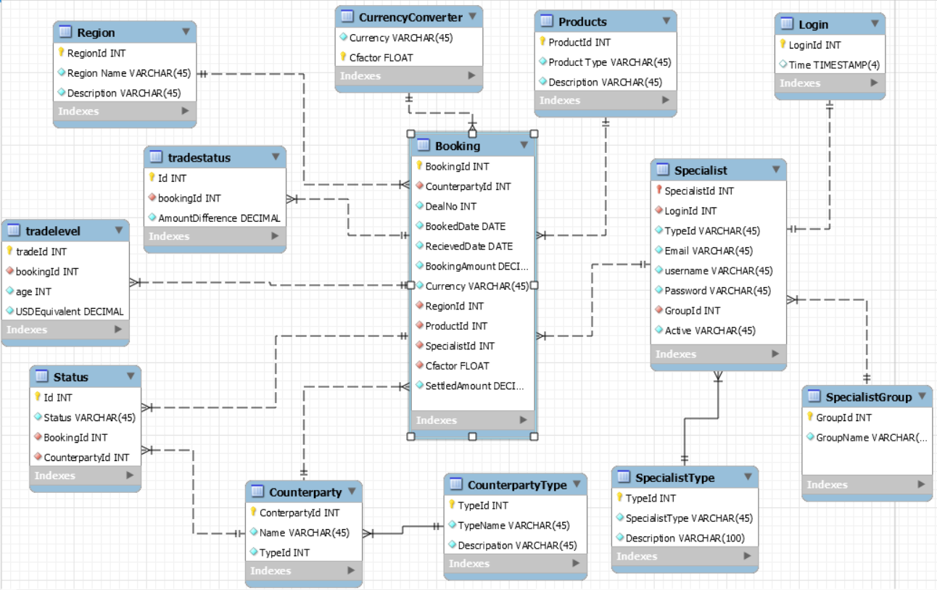
FINAL ERD

Slide 6
KEY FUNCTIONS
This includes adding specialist , markets and products to the system.
Booking of a trade of a specific product and market by a particular specialist belonging to a particular group.
Adding required entries of booking such as booking amount , settled amount ,currency etc.
Management of counterparties input and performances by various reporting work such as Fail Report and Defaulters report.
Evaluation of company revenue, dues and profits.
Evaluation of a specialist on the basis of number and amount of the trades settled.
Evaluation of total business company is getting from a particular region.

Slide 7
USE CASE
Booking of a trade.
Adding specialist , product etc.
Currency conversion in case of different currency trade.
Updating status of a trade.
Updating age of a trade settlement.
Generation of various financial reports for counterparty analysis.
Generation of reports for specialist analysis and revenue of company.

Slide 8
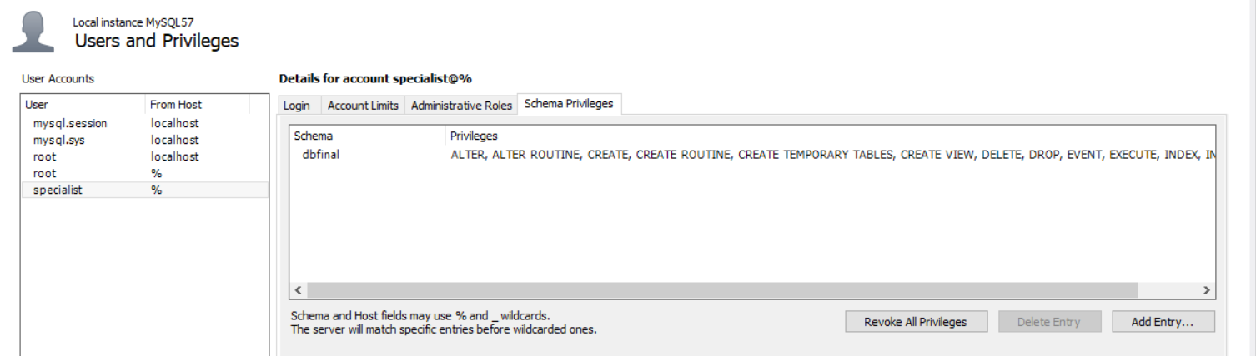
USERS & PRIVILAGES

Slide 9
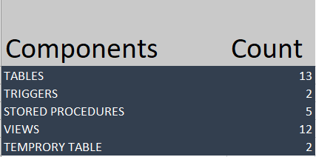
COMPONENTS

Slide 10
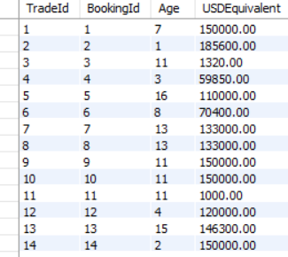
STORED PROCEDURES
PROC_AGE
To calculate age of the trade.
PROC_usdeq
To calculate the amount in USD.

Slide 11
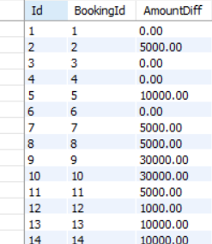
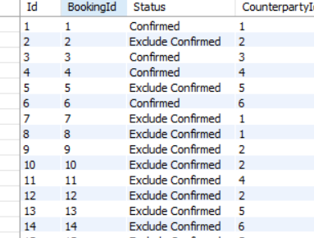
PROC_amountdiff
To calculate difference in the booking and settled amount.
PROC_status
To update the status of a particular trade.

Slide 12
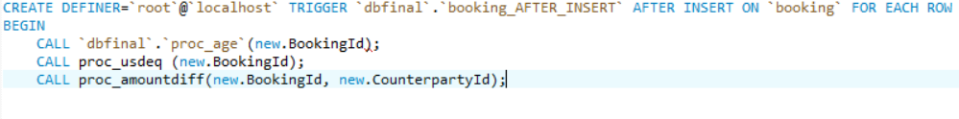
TRIGGERS
Below triggers has been used to update different tables such as tradelevel , status etc.

Slide 13
VIEWS
Following views are used to perform financial reporting and evaluation calculation for company and related regions and markets.
Cassreport
Defaulterscount
Dues
Failreport
Highvaluereport
Marginfails
Regionbooking
Specialistbusiness
Groupbusiness
Totalbookedamount
totalsettledamount

Slide 14
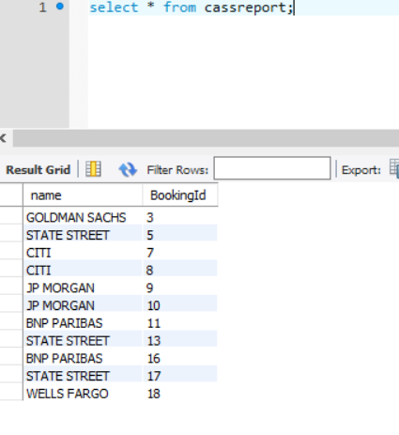
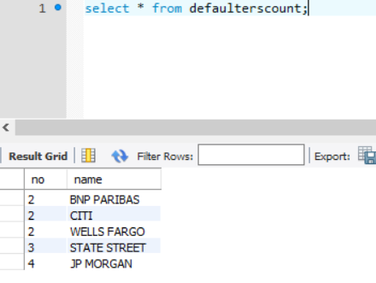
Cassreport view
Defaulaterscount view

Slide 15
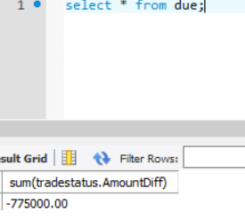
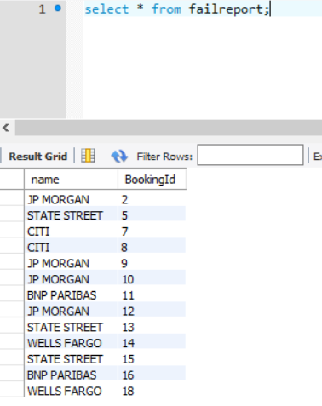
Due view
Failreport view

Slide 16
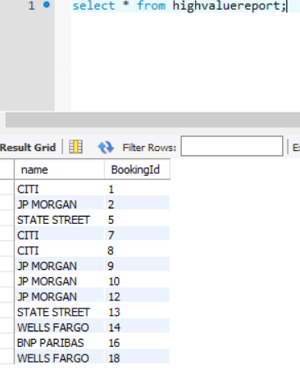
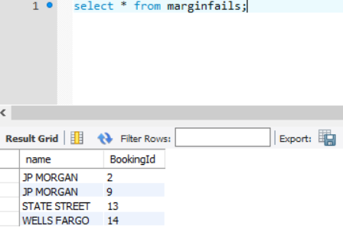
Highvaluereport view
Marginfailsreport view

Slide 17
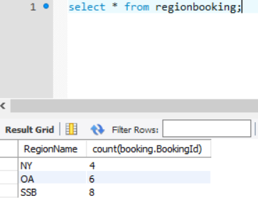
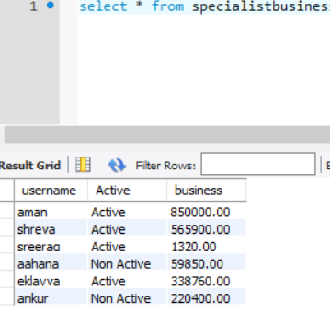
Regionbooking view
Specialistbusiness view

Slide 18
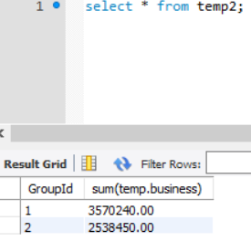
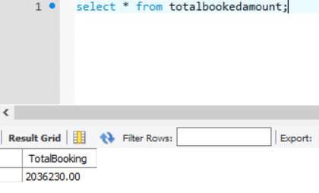
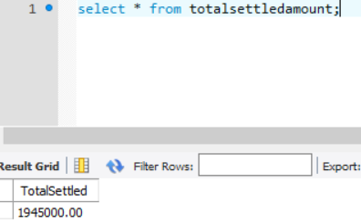
Groupbusiness view
Totalbookedamount view
Totalsettledamount view

Slide 19


